Slide 1
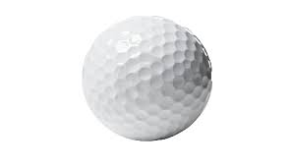

Bayesian Analysis of PGA Golf Scores with Py-Stan Part I Jamie Bernardin – September 2017

Slide 2
Agenda
Basic Golf Score Stats
Multi-Level Model of Scores and Tournaments
Stokes Gained Intro and Score Regression
Time Series Modeling of Strokes Gained
Putting it all Together: Predictive Score Model
Analysis and Next Steps
Appendix – Data Preparation

Slide 3
Basic Score Analysis
Players are free agents and can play in any of about 40 tournaments each year
Each tournament is 4 games (rounds), with approximately a 50% cut after 2 round
Modeling implications:
All players don’t play the same rounds/tournaments
Each tournament plays differently due to course difficulty, length, putting greens, etc
Weather plays a factor (not modeled here)

Slide 4
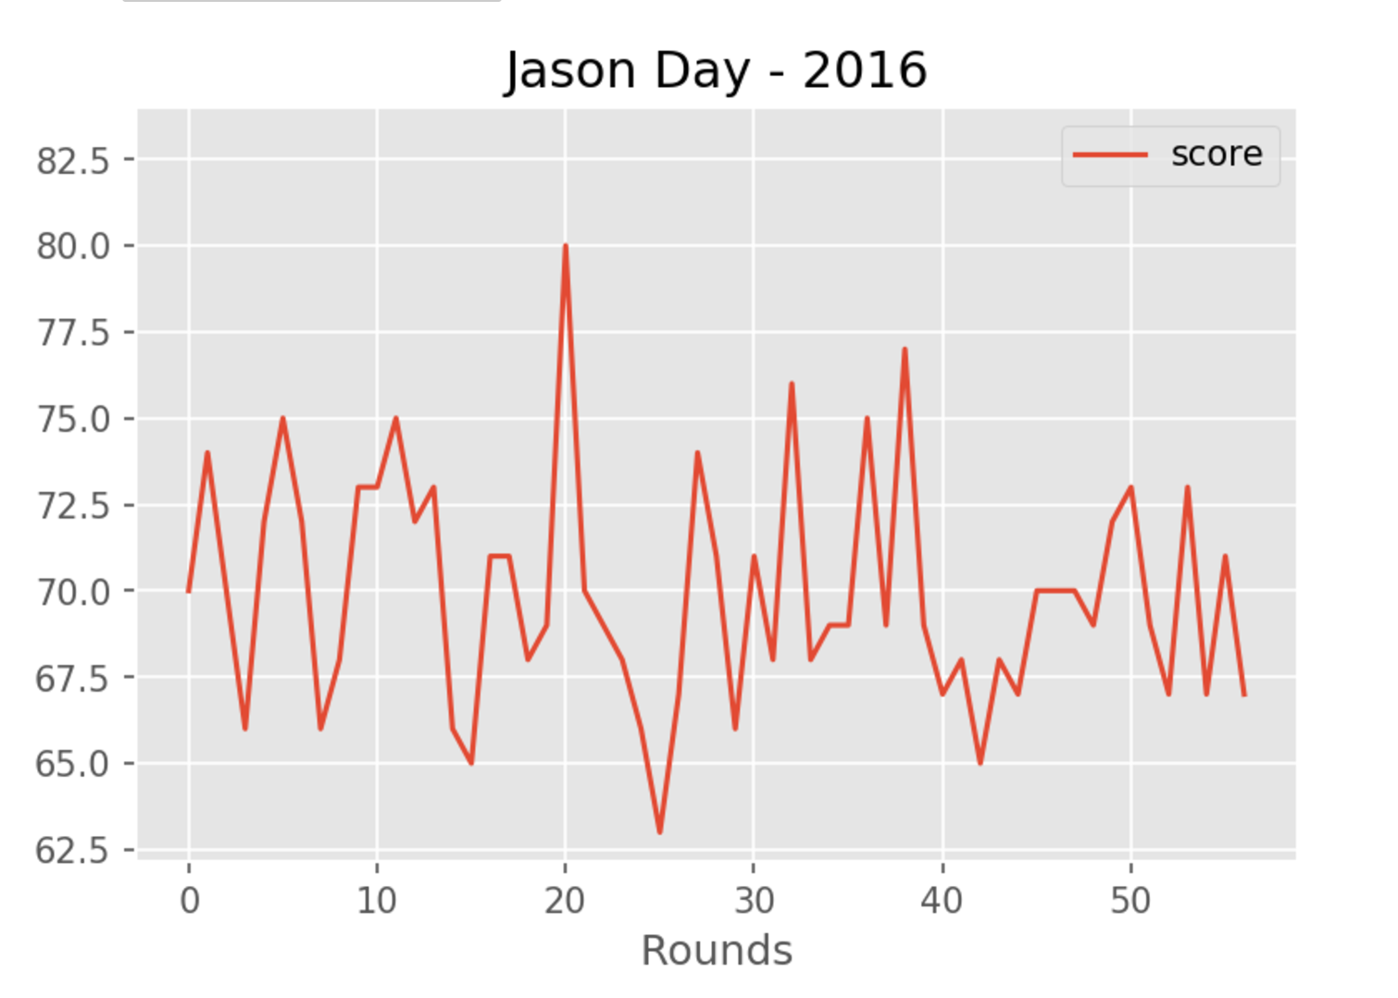

Slide 5
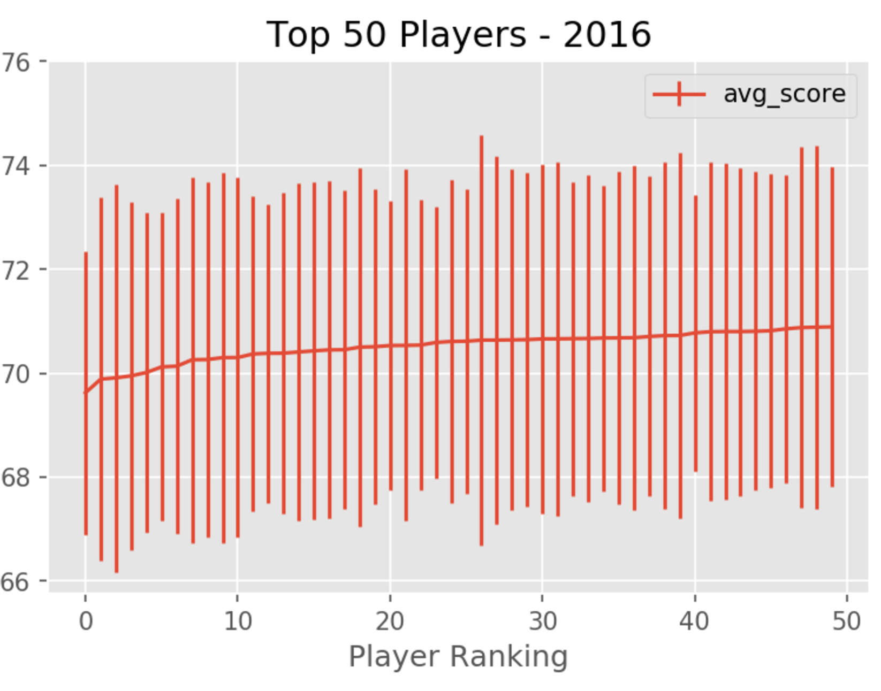

Slide 6
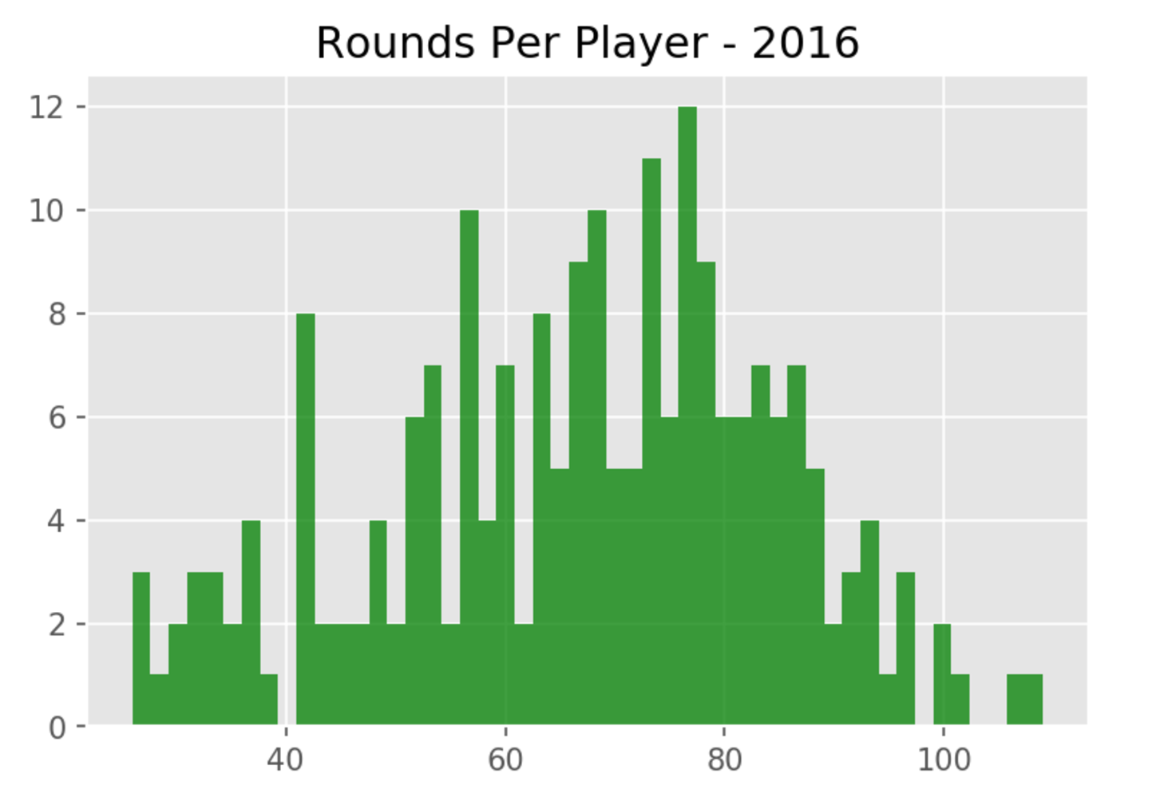
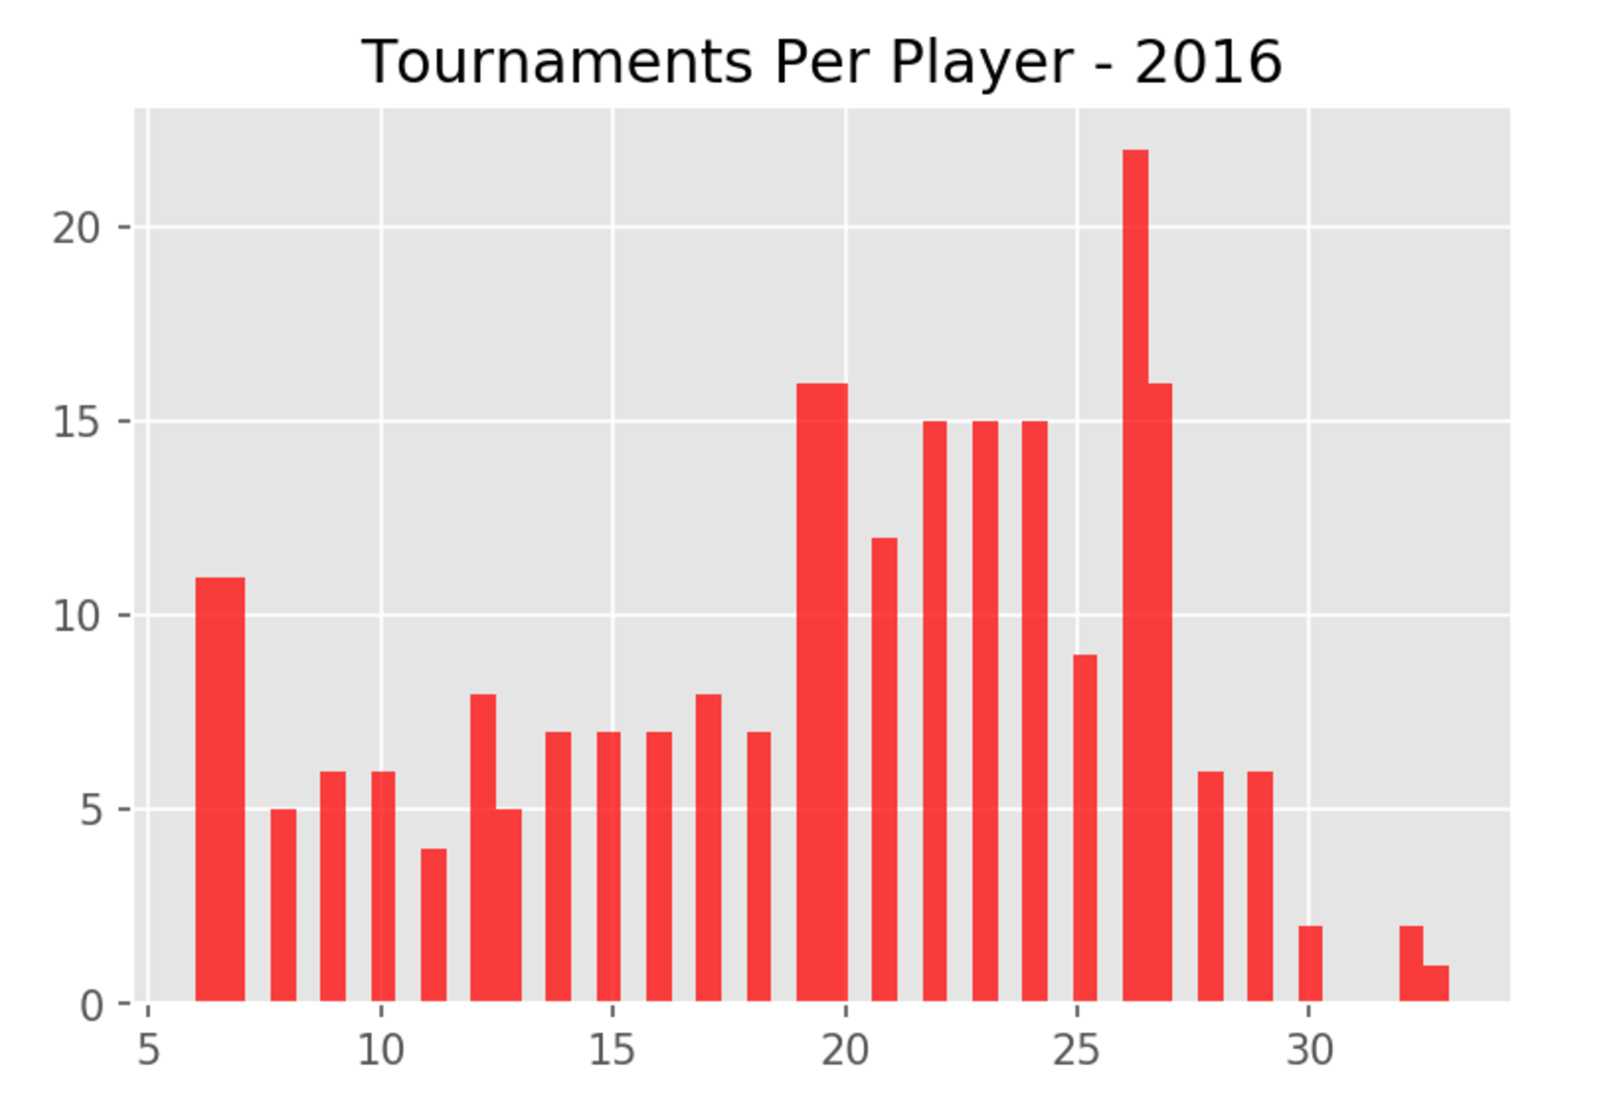
Number of Rounds/Tournaments

Slide 7
Time Series Forecasting on Scores ?
Player scores are very weakly auto-correlated in time, making series-forecasting not very useful
We will and discuss data that DOES have auto-correlation and use that later (strokes gained per round)
The following example is very typical

Slide 8
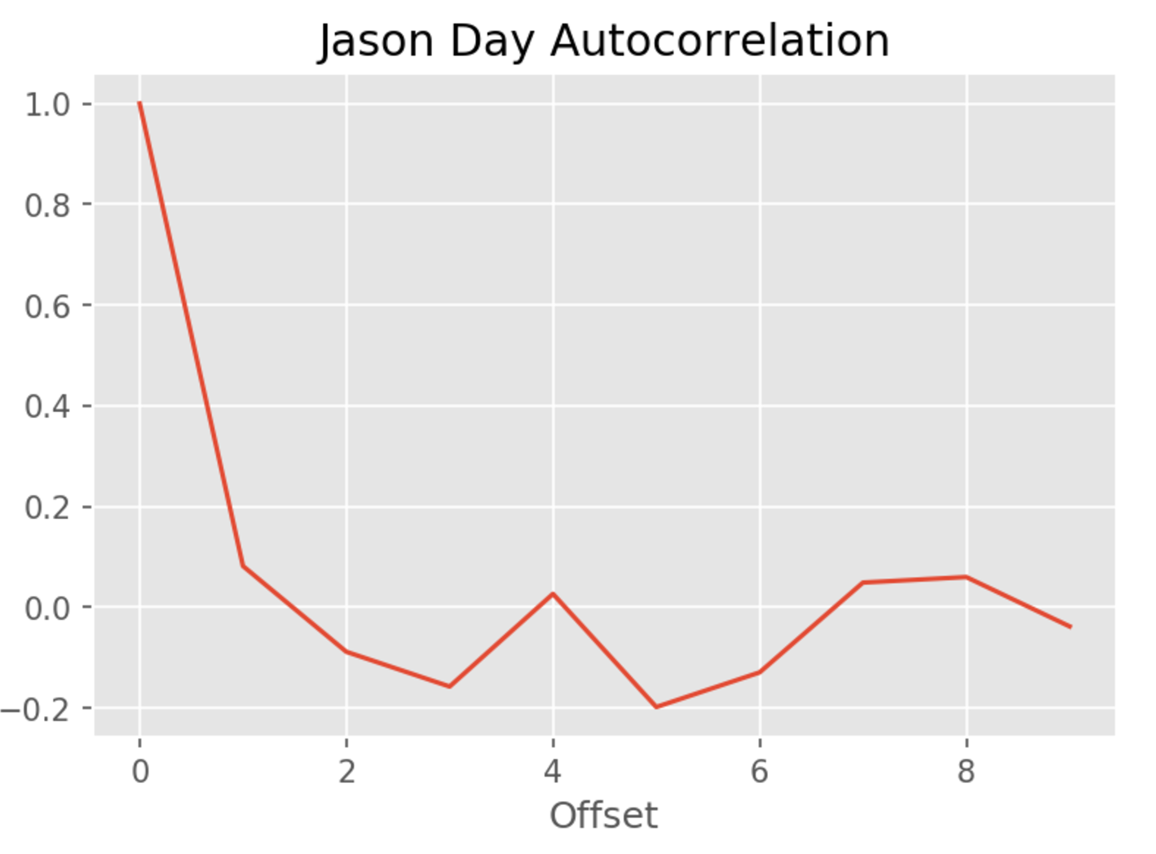

Slide 9
Using Stan to Understand Actual Performance
We’d like to calculate normalized average performance given
Each player plays a different set of tournaments
Each tournament plays differently
Create a model with both tournament/course offset and player ability and variance
Need to use parameter mapping to address ragged arrays (see Data Preparation Appendix)

Slide 10
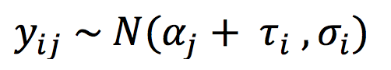
Multi-Score Model
Golf scores for each player i, course j:
course offset player ability player noise
With the following priors:

Slide 11
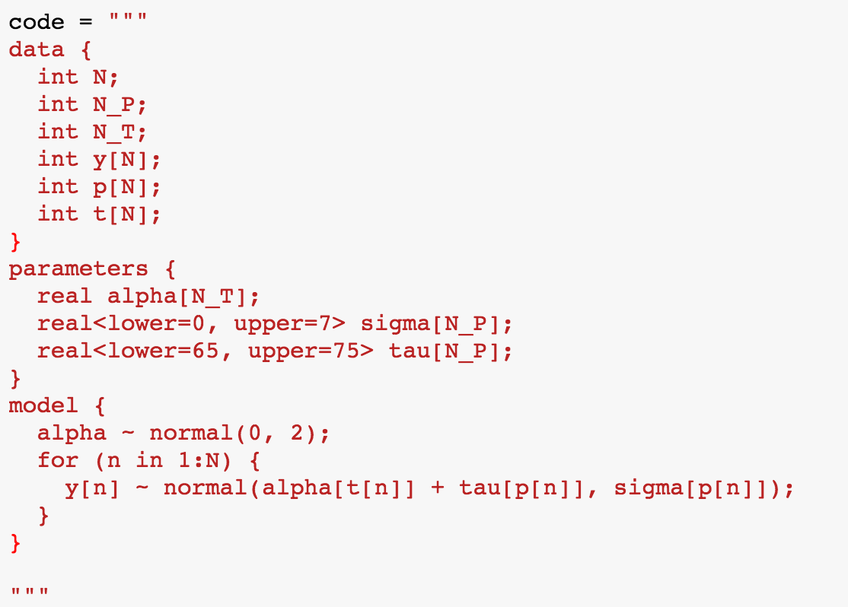
Multi-Score Model

Slide 12
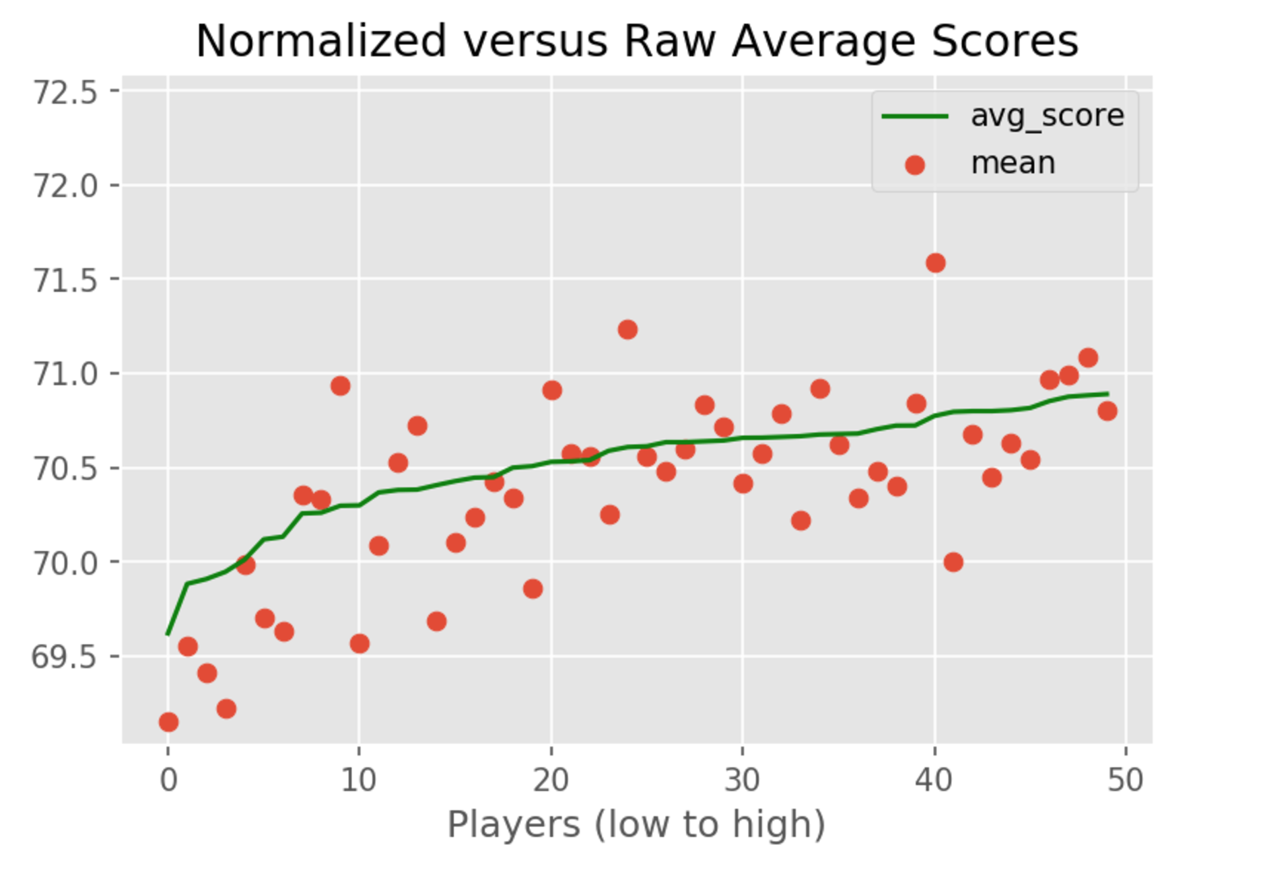
Stan Results
Raw average scores are inaccurate compared with model results shows which show a much different ranking

Slide 13
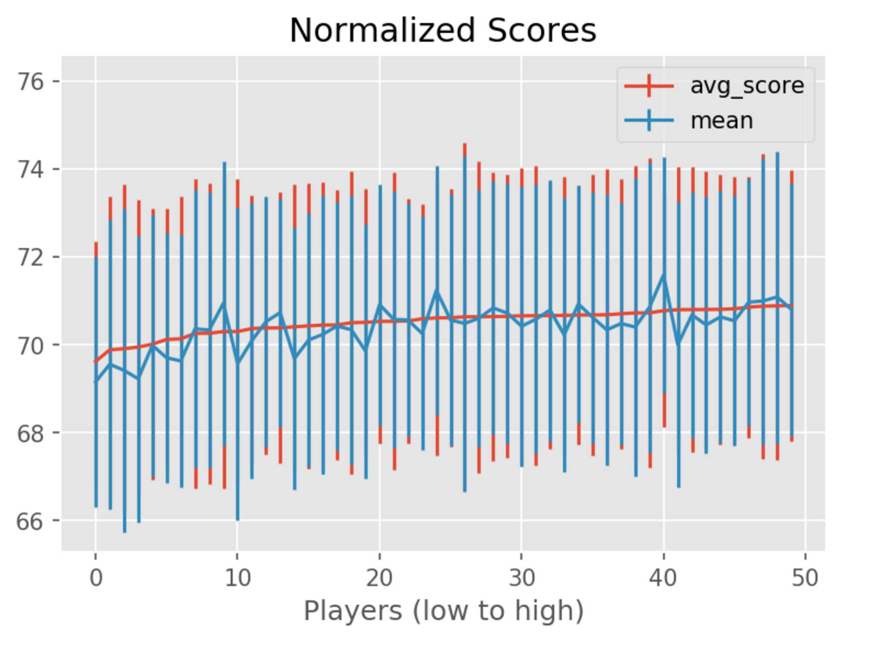
Reduced Variance Using Model
Variance is reduced using multi-factor model
Difference is about 8-10% reduction in STD.

Slide 14
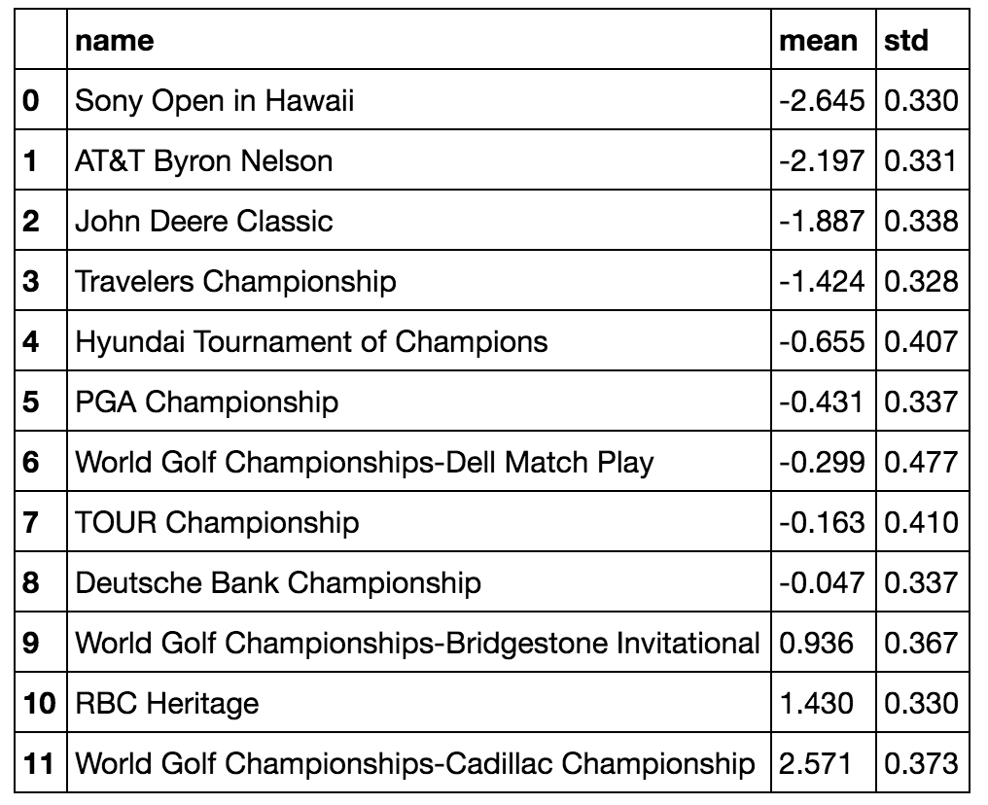
Example Tournament/Course Offsets

Slide 15
Enter Strokes Gained*
How good was a shot compared with peers?
Examples:
Player average for 20-foot putt is 1.75 strokes
If a player makes a 20-foot putt, she gained 0.25 strokes
If a player hits a tee shot into the woods, he gains at least negative 1 stroke since the average player would need at least 1 stroke to recover
Strokes Gained was invented by Mark Broadie at Columbia. It is now part of golfing
vernacular and widely used by announcers and players to understand shot performance

Slide 16
Strokes Gained (cont)
Each shot (stroke) has a strokes-gained factor computed by the PGA
Each shot is broken up into 4 categories:
Tee shot (Driver or 3 wood mostly)
Approach to green (iron shots)
Around the green (chip and pitch shots)
Putting

Slide 17
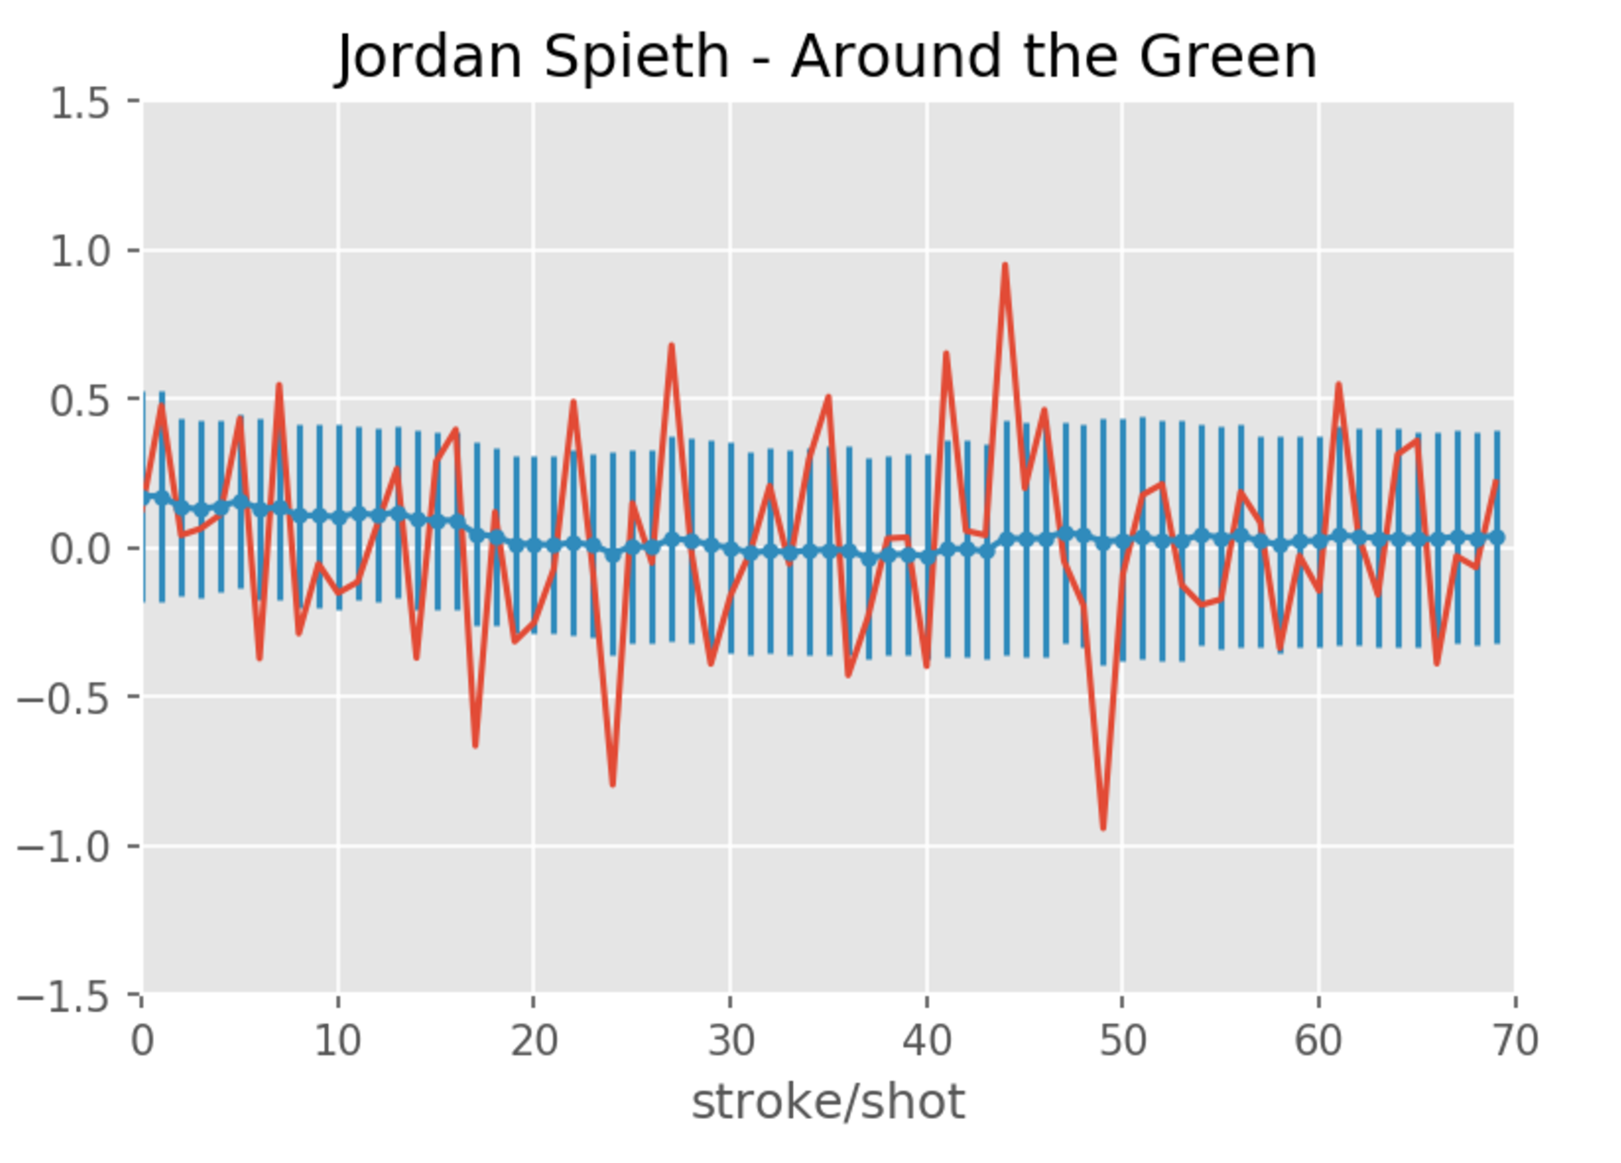
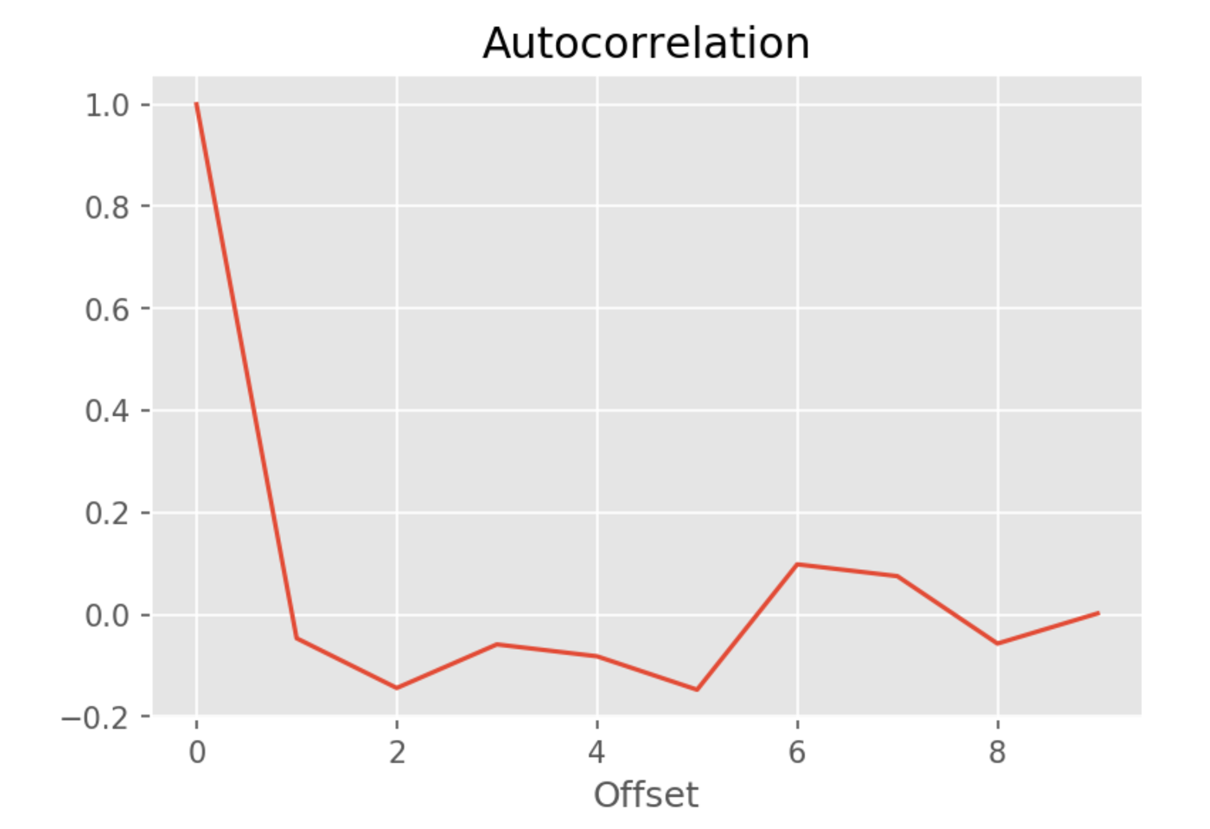
Strokes-Gained Analysis
Example player for one tournament
Very noisy shot-to-shot
Autocorrelation is weak
Same result for all players/categories
Not a good parameter forr time-series regression

Slide 18
Total Strokes Gained
Strokes gained per round/game is an interesting number
We sum the strokes gained per shot over a round in all four categories and use it to fit the score
We can do a regression in Stan to figure out the linear coefficients that relate total strokes gained per round, to total score

Slide 19
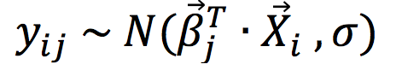
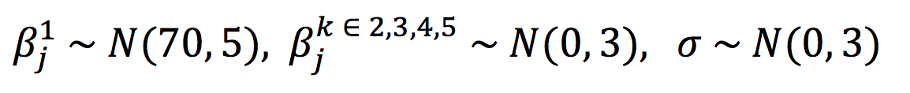
Strokes Gained Regression Model
Golf scores for each player i, course j:
SG coef player SG results noise
With the following priors:

Slide 20
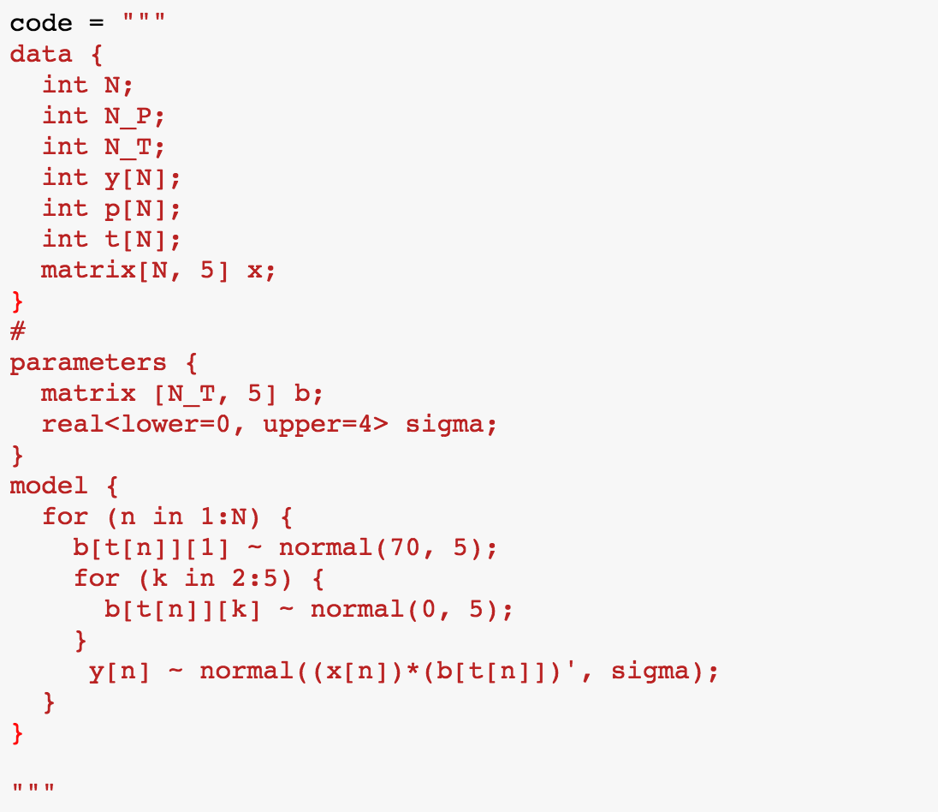
Stan Code

Slide 21
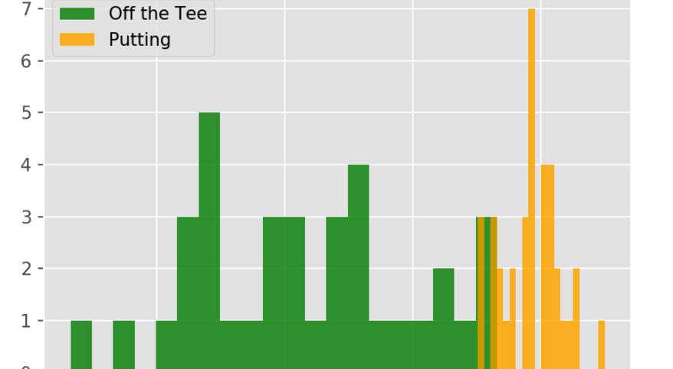
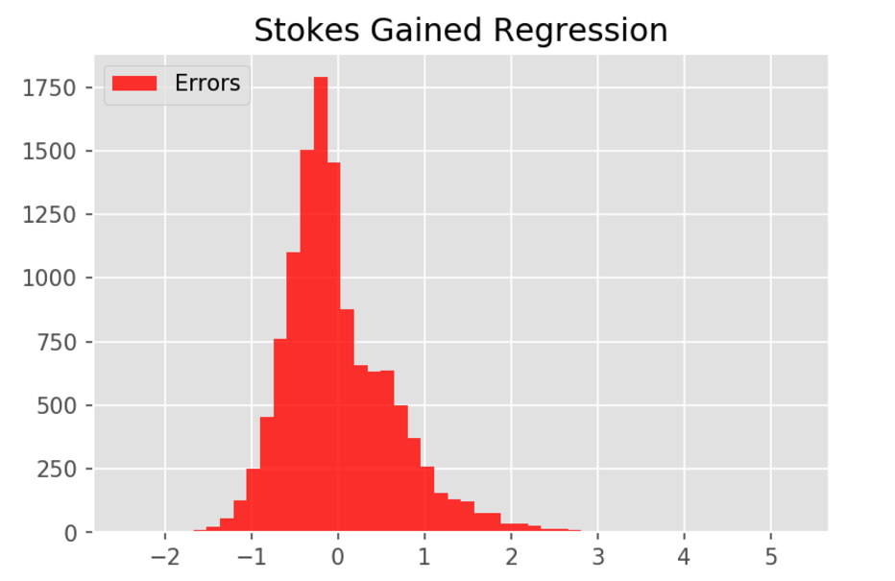
Course Strokes-Gained Coefficients
Different tournaments/courses have different coefficients that fit SG to scores
Using SG linear regression gives us reasonable accuracy for deriving score from 4 SG categories

Slide 22
Forecasting of Strokes Gained Total
It’s very natural for golfers to summarize their performance for a round:
‘My putting was hot, but my tee shots were awful’
Confidence is everything, and golfers remember their last performance
The autocorrelations bare this out and we can use it to forecast

Slide 23
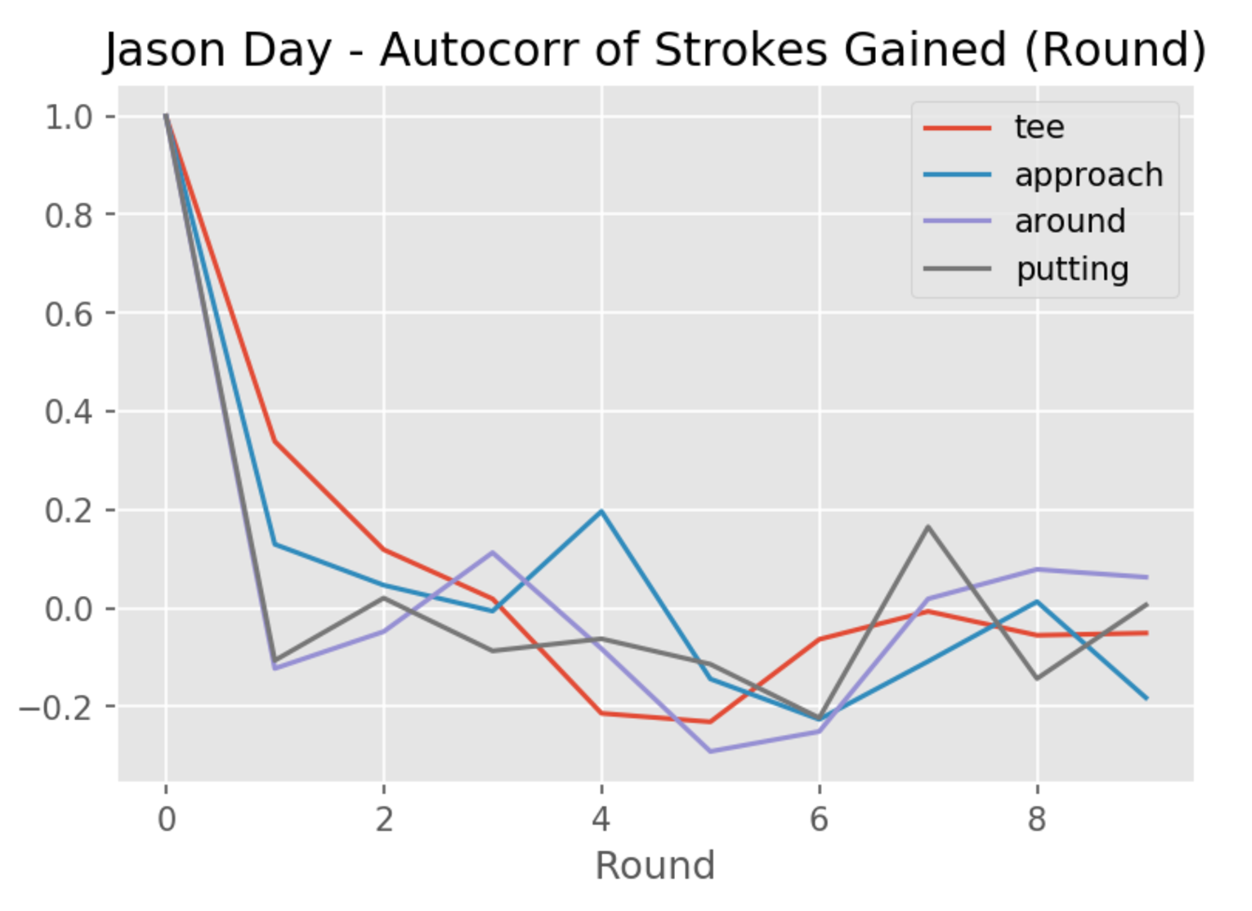
“Remembering” the Last Performance
Summing SG categories for a given round, then examining autocorrelations for rounds gives promising results
Particular strong signal for offset=1

Slide 24
Mean-reverting / AR(1)
Golfers get hot or perform poorly, but tend to revert to their mean in all categories
Stationary AR(1) is same as OU mean-reverting stochastic process which gives us a natural way to think about golfing dynamics
We use previous 30 rounds to establish mean and reversion strength

Slide 25
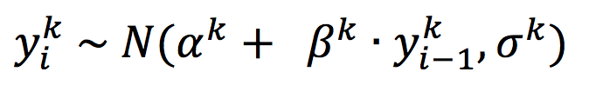
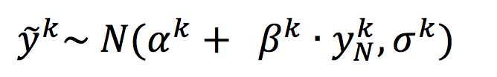
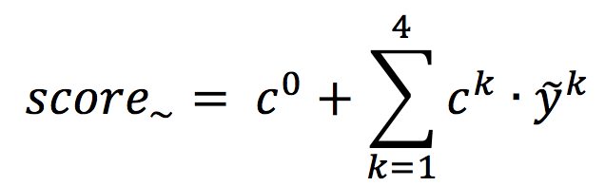
AR(1) Strokes Gained Forecasting
Strokes gained factor k, for each game i:
offset regress coef noise factor
Strokes Gained predictions:
Score Prediction using Strokes Gained regression data:

Slide 26
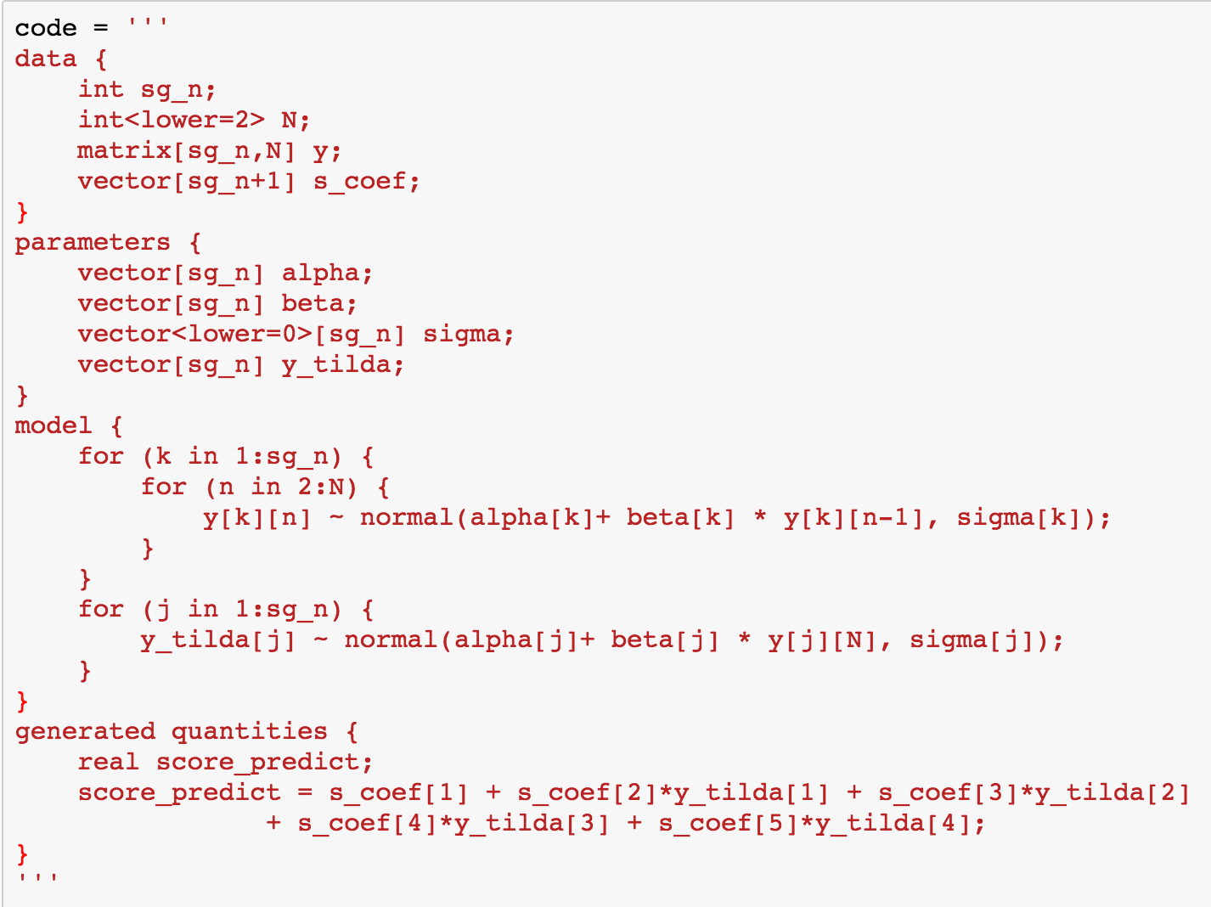
Time-Series Forecasting

Slide 27
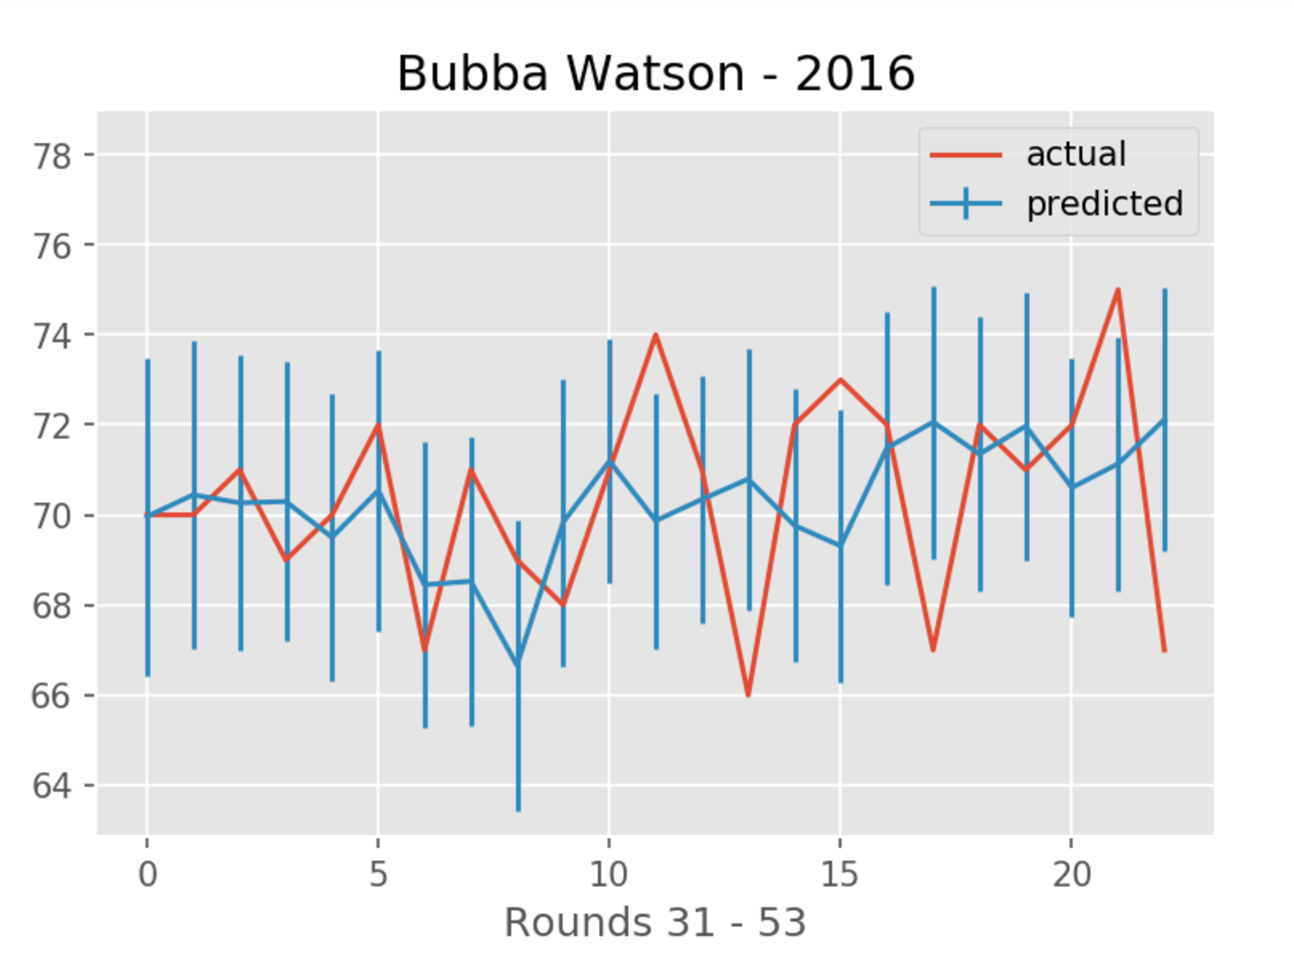

Slide 28
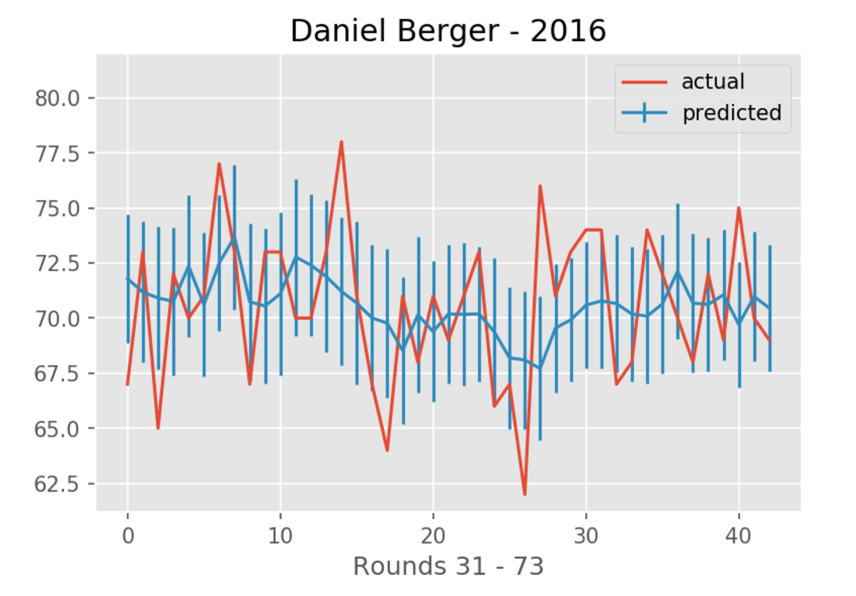

Slide 29
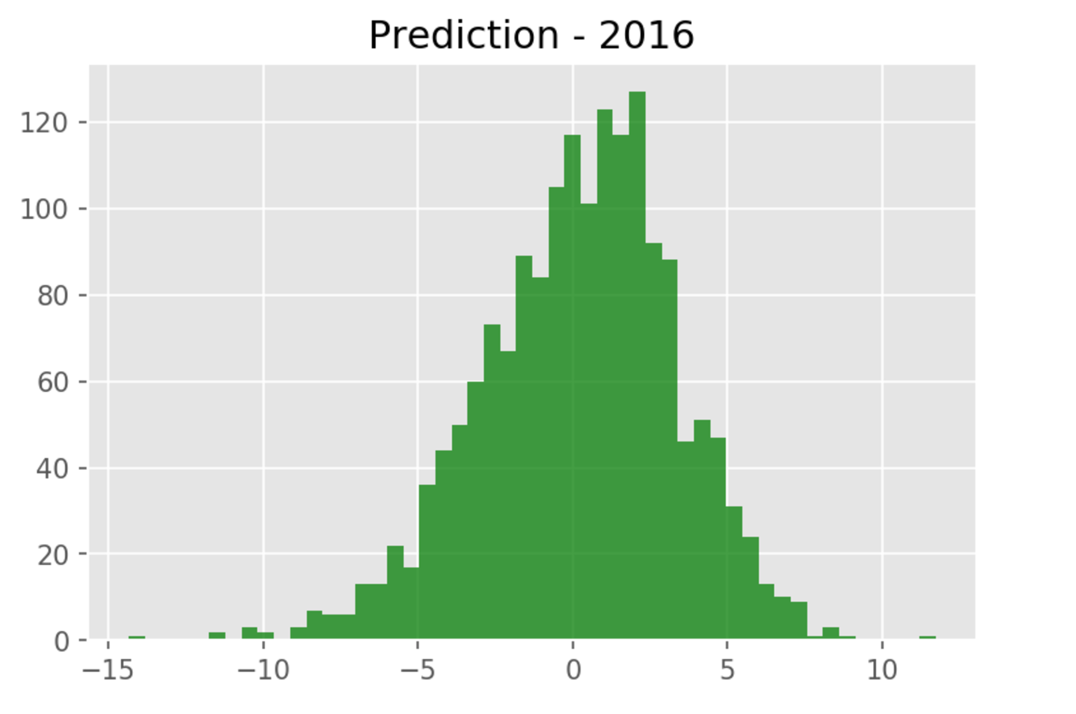
Forecasting Accuracy

Slide 30
Summary
This was a phase one exploring PGA shotlink data with Stan
Some interesting insights emerged from multi-factor model and we reduced uncertainty
Total strokes gained per round shows promise for forecasting
Score forecasting results were generated
More work needs to be done to optimize results

Slide 31
Data Preparation
Shotlink data available from PGA for research only
Flat file for each year containing every shot from every player with dozens of attributes (~ 1 Million shots/year)
Using Pandas alone to prepare the data was too complicated
Created SQL database to un-flatten info with make associative and aggregate tables (check out “schema-data-pipeline.ipynb” ipython notebook containing SQL)

Slide 32
Data Cleansing
Created stored procedures to clean, filter, and aggregate data (faster by far)
Examples:
Not every player finished every competition
Some rounds are split over two days due to weather
Players needed sufficient play to be considered in some analysis

Slide 33
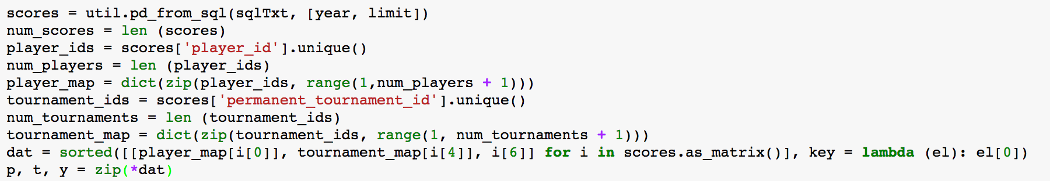
Preparing Data for Stan Calc
Different players played different courses
Stan does not support ragged arrays
Must create maps from parameter index, to parameter:

